Slide 1
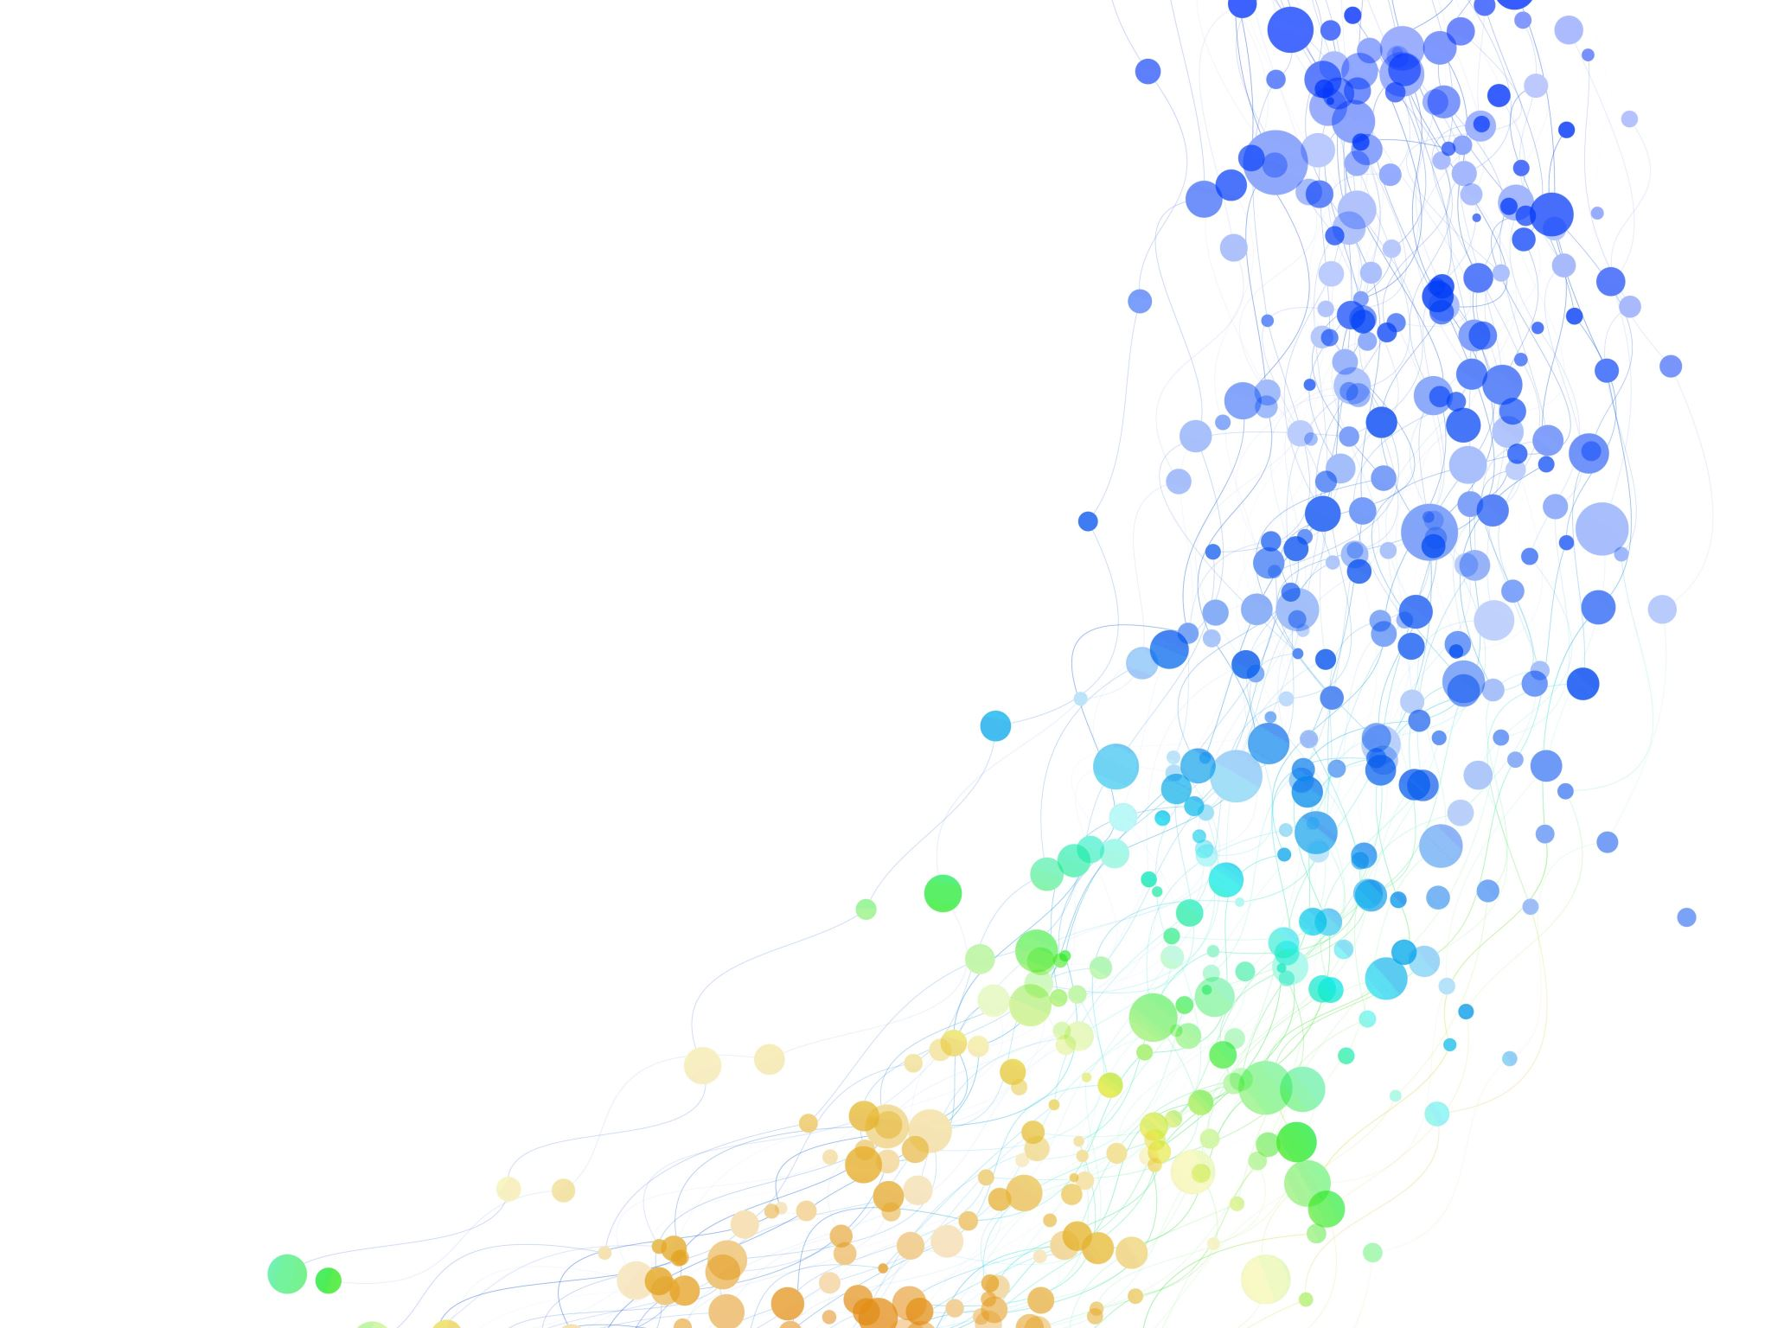

Assigning Archetypes to Relief Pitchers
By Jacob Weber

Slide 2

Overview
Background
Data Cleaning & Variable Creation
Modeling Process
Double Play Specialist
Momentum Stopper
Inning Eater

Slide 3
Background
Cincinnati Reds Case Competition
Industry Experience
Prior work on valuing Relief Pitchers

Slide 4
Modeling Process
Used STAN Language
Valued Higher #’s
Easily Repeatable

Slide 5
Dataset Cleaning & Variable Creation
Filtering for Qualified Relievers and for 2023
Unable to use prior seasons
Creating and Altering Statistics from the Dataset
FIP- to FIP+
Games Relieved
Not Walked %
Numeric Changes
Incorrect Initial Variable Types

Slide 6

Double Play Specialist
Choosing the Statistics
GB %
Soft %
Swing %

Slide 7
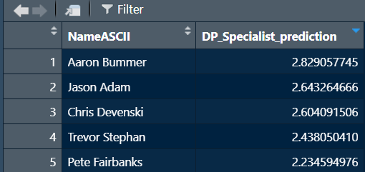
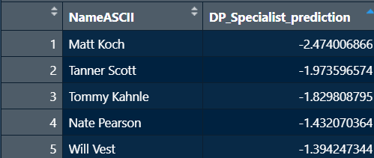
Top 5’s

Slide 8
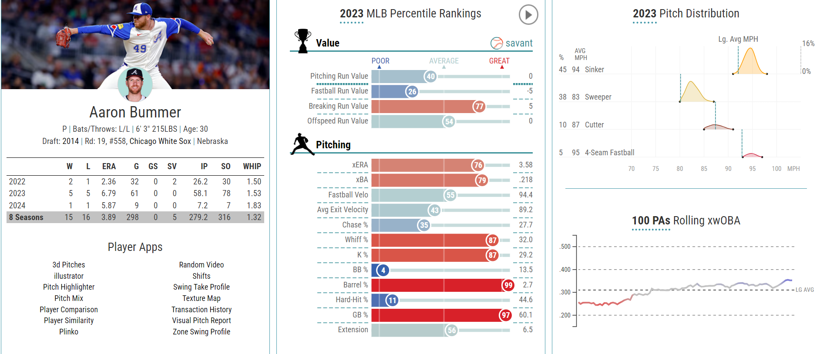
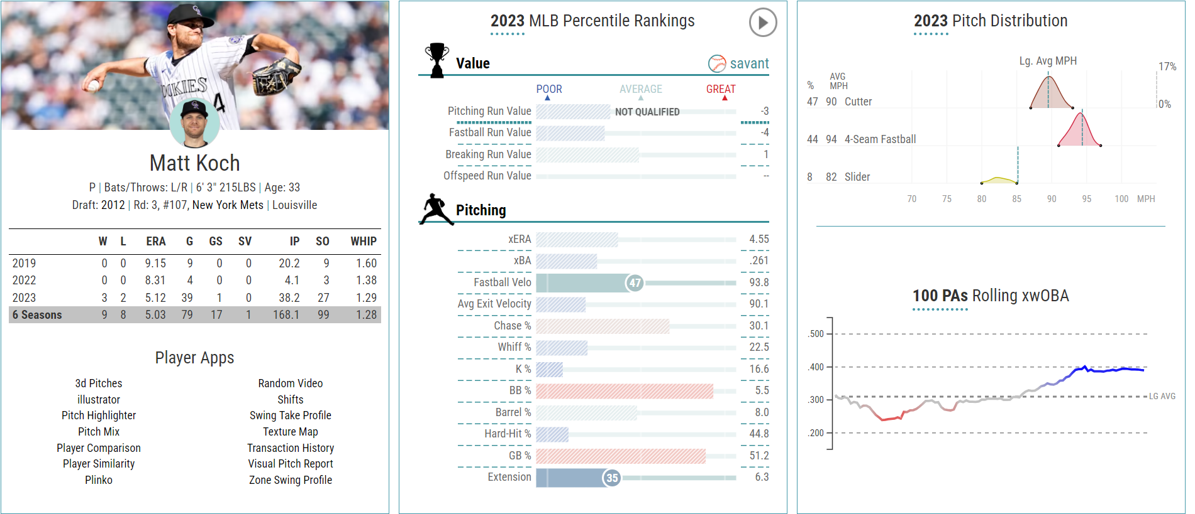
Deeper Dive
Aaron Bummer
Expected Values are Substantially better than actual
Throws Sinker
Matt Koch
Has a good GB % but is lack luster in the other requirements
High BB%

Slide 9

Momentum Stopper
Choosing the Statistics
Soft %
K %
LOB %
FIP+

Slide 10
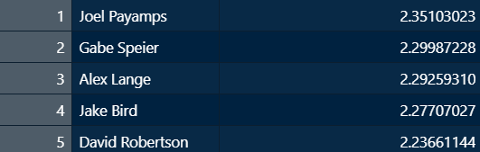
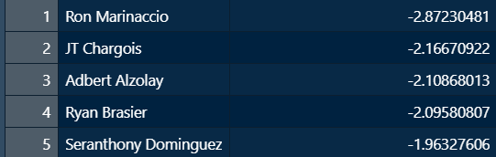
Top 5’s

Slide 11
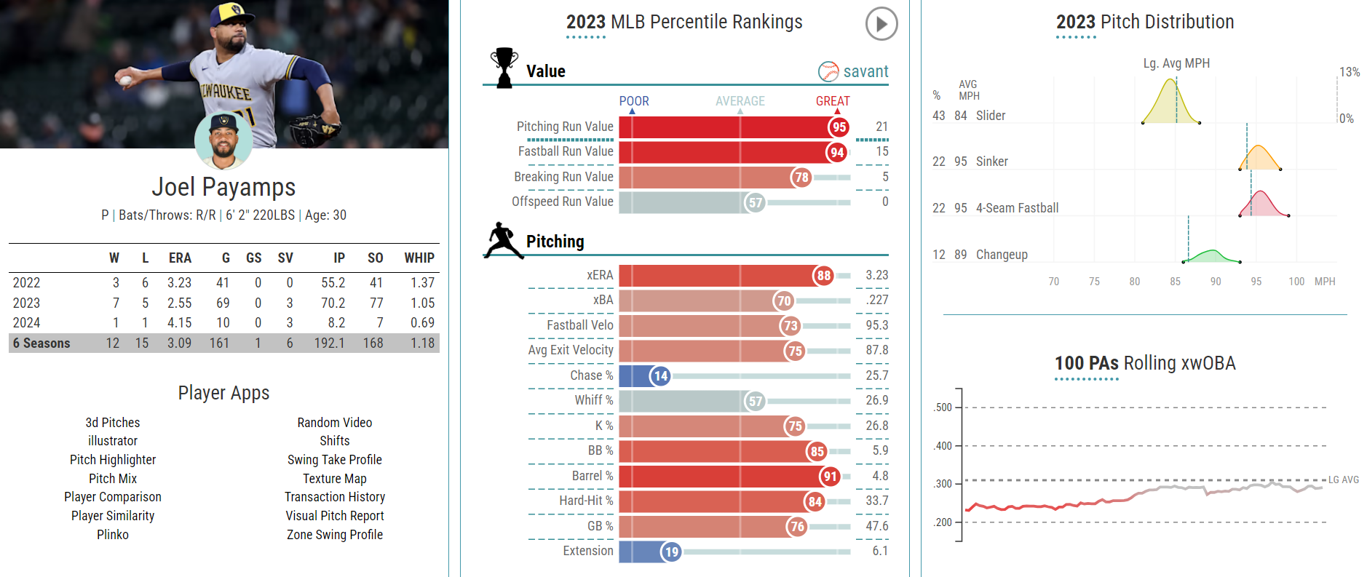
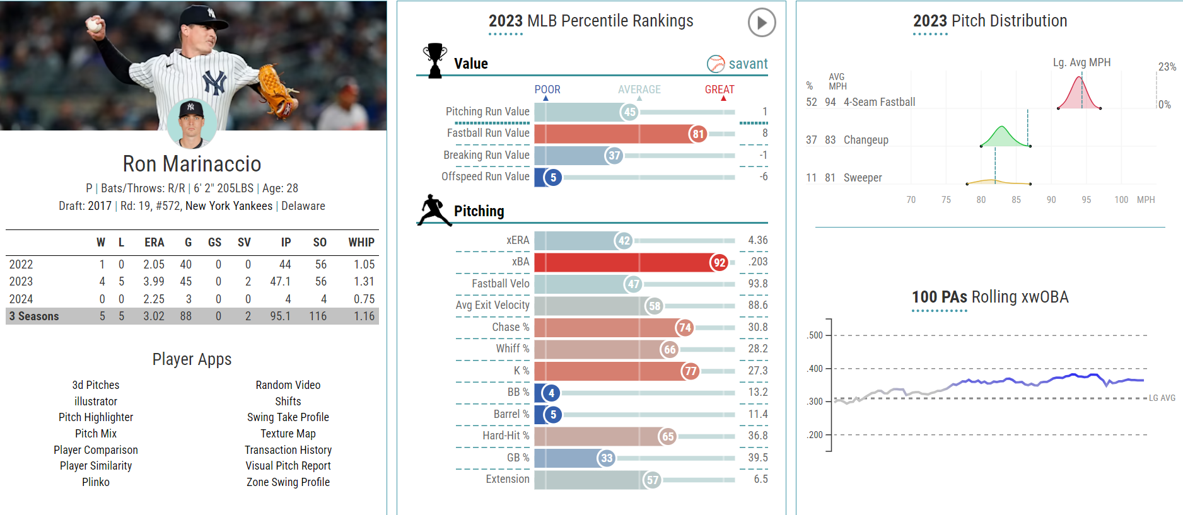
Deeper Dive
Joel Payamps
Excels in Many Metrics
Typical Use in 8th
Ron Marinaccio
Unlucky in 2023
Too Many Baserunners

Slide 12

Inning Eater
Choosing the Statistics
Not Walked %
Contact %
Swing %

Slide 13
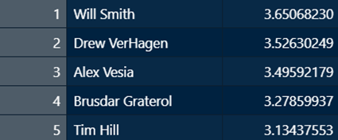
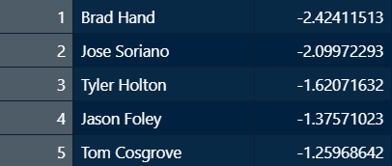
Top 5’s

Slide 14
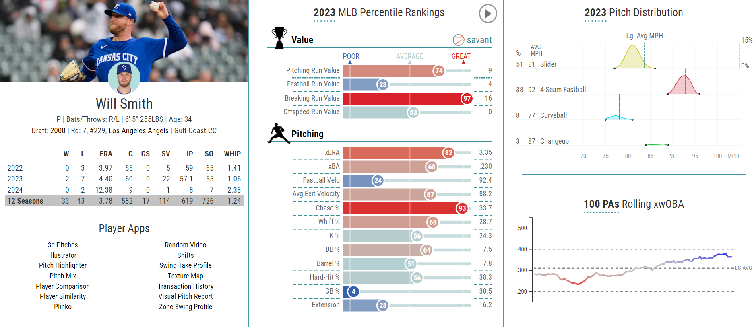
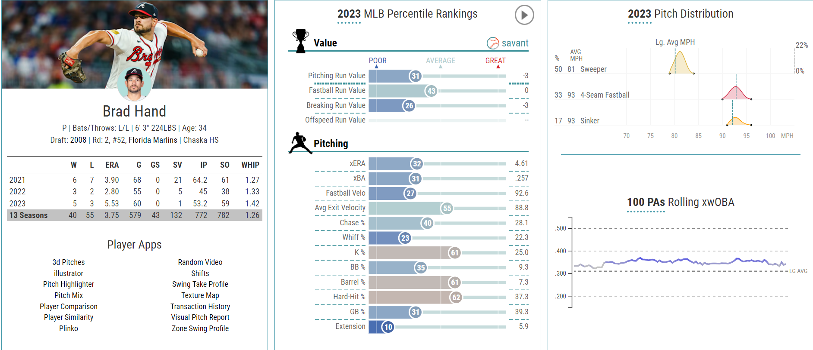
Deeper Dive
Will Smith
Keeps Runners off Base
Great Chase w/ Lower Whiff
Brad Hand
Walks too Many Batters
Saw a Major Regression from 2022 -> 2023

Slide 15
Sources
Dataset: fangraphs.com
Deeper Dive Images: baseballsavant.com

